Slide 1

POLS232 Citizen Politics: Public Opinion and Elections
Electoral Turnout
Jack Vowles

Slide 2
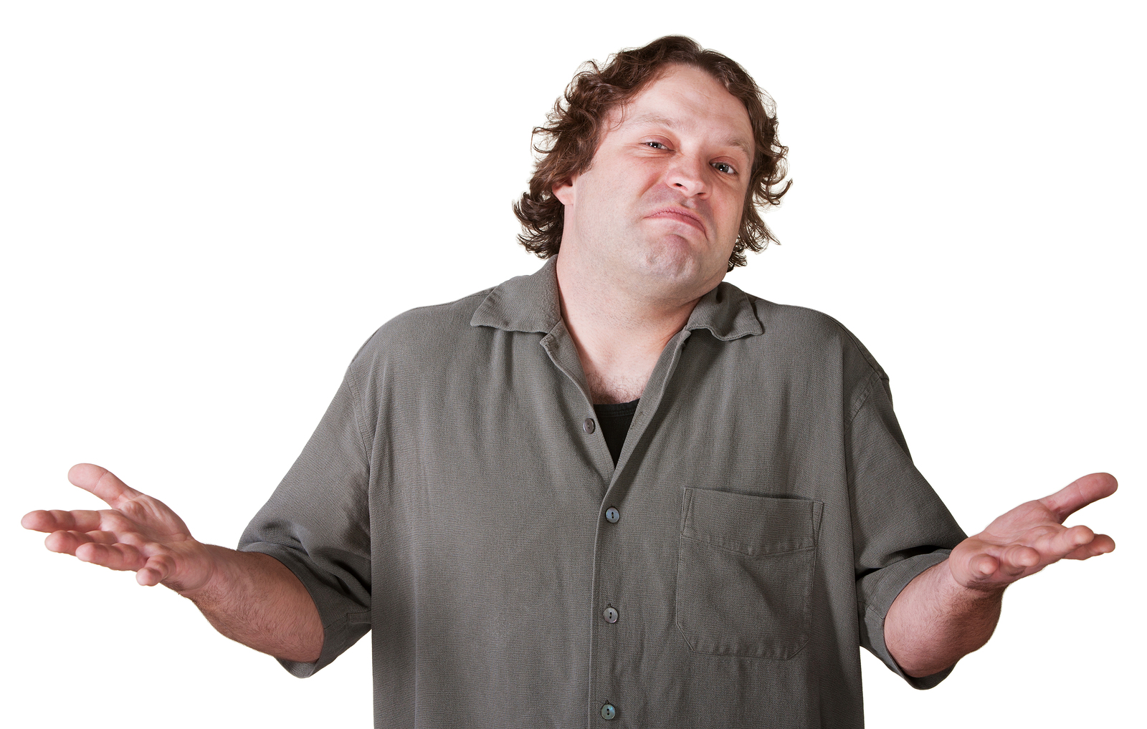
Why care about turnout?
Increasing ‘active’ participation is not a substitute for electoral turnout – active participants are a relatively small proportion of citizens
‘In the end elections are the most egalitarian political mechanism we have and can have. Too often the calls for increased participation privilege those who have more resources to participate (Przeworski 2010, 169)

Slide 3
Methodological Issues
Official Data
Enrolment or Age-eligible Base? (Nagel 1988)
Non-eligible persons not easily estimated
Enrolment data incomplete but may also contain duplicates and the deceased (Mellon et al 2018)
Sample Survey Data
Recall error or misreporting (Wright 1993)
Low response rates among nonvoters (Sciarini and Goldberg 2017)
Weighting
‘Big Data’: but not accessible in all countries

Slide 4
Macro Measuring it
Vote to Registered Population (VRP): enrolment base
Vote to Voting Age Population (VAP): http://www.idea.int/
Vote to Voting Eligible Population (VEP): see the United States http://www.electproject.org/national-1789-present

Slide 5
Electoral Turnout 1971-2014, 31 consistent democracies
Source: Vowles (2018)

Slide 6
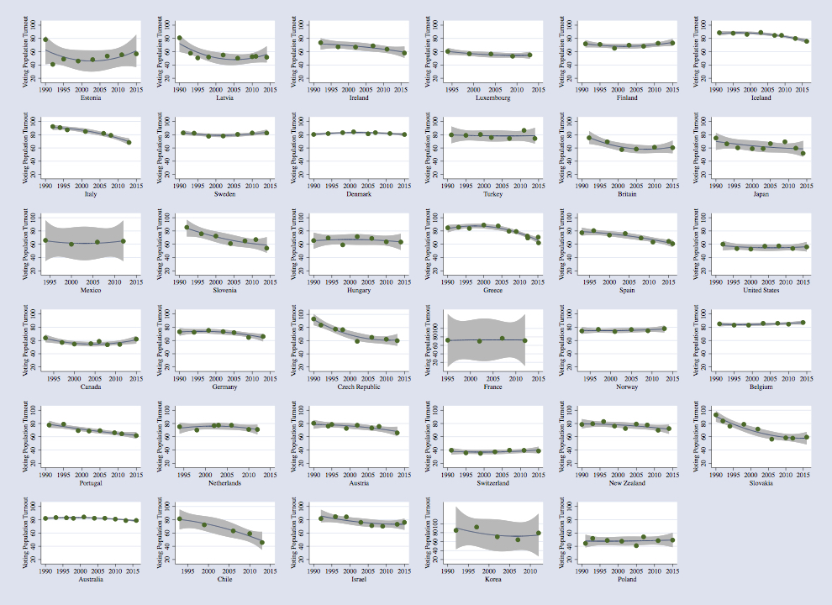
OECD Countries 1990-2016
Hellwig, Kweon & Vowles 2020

Slide 7
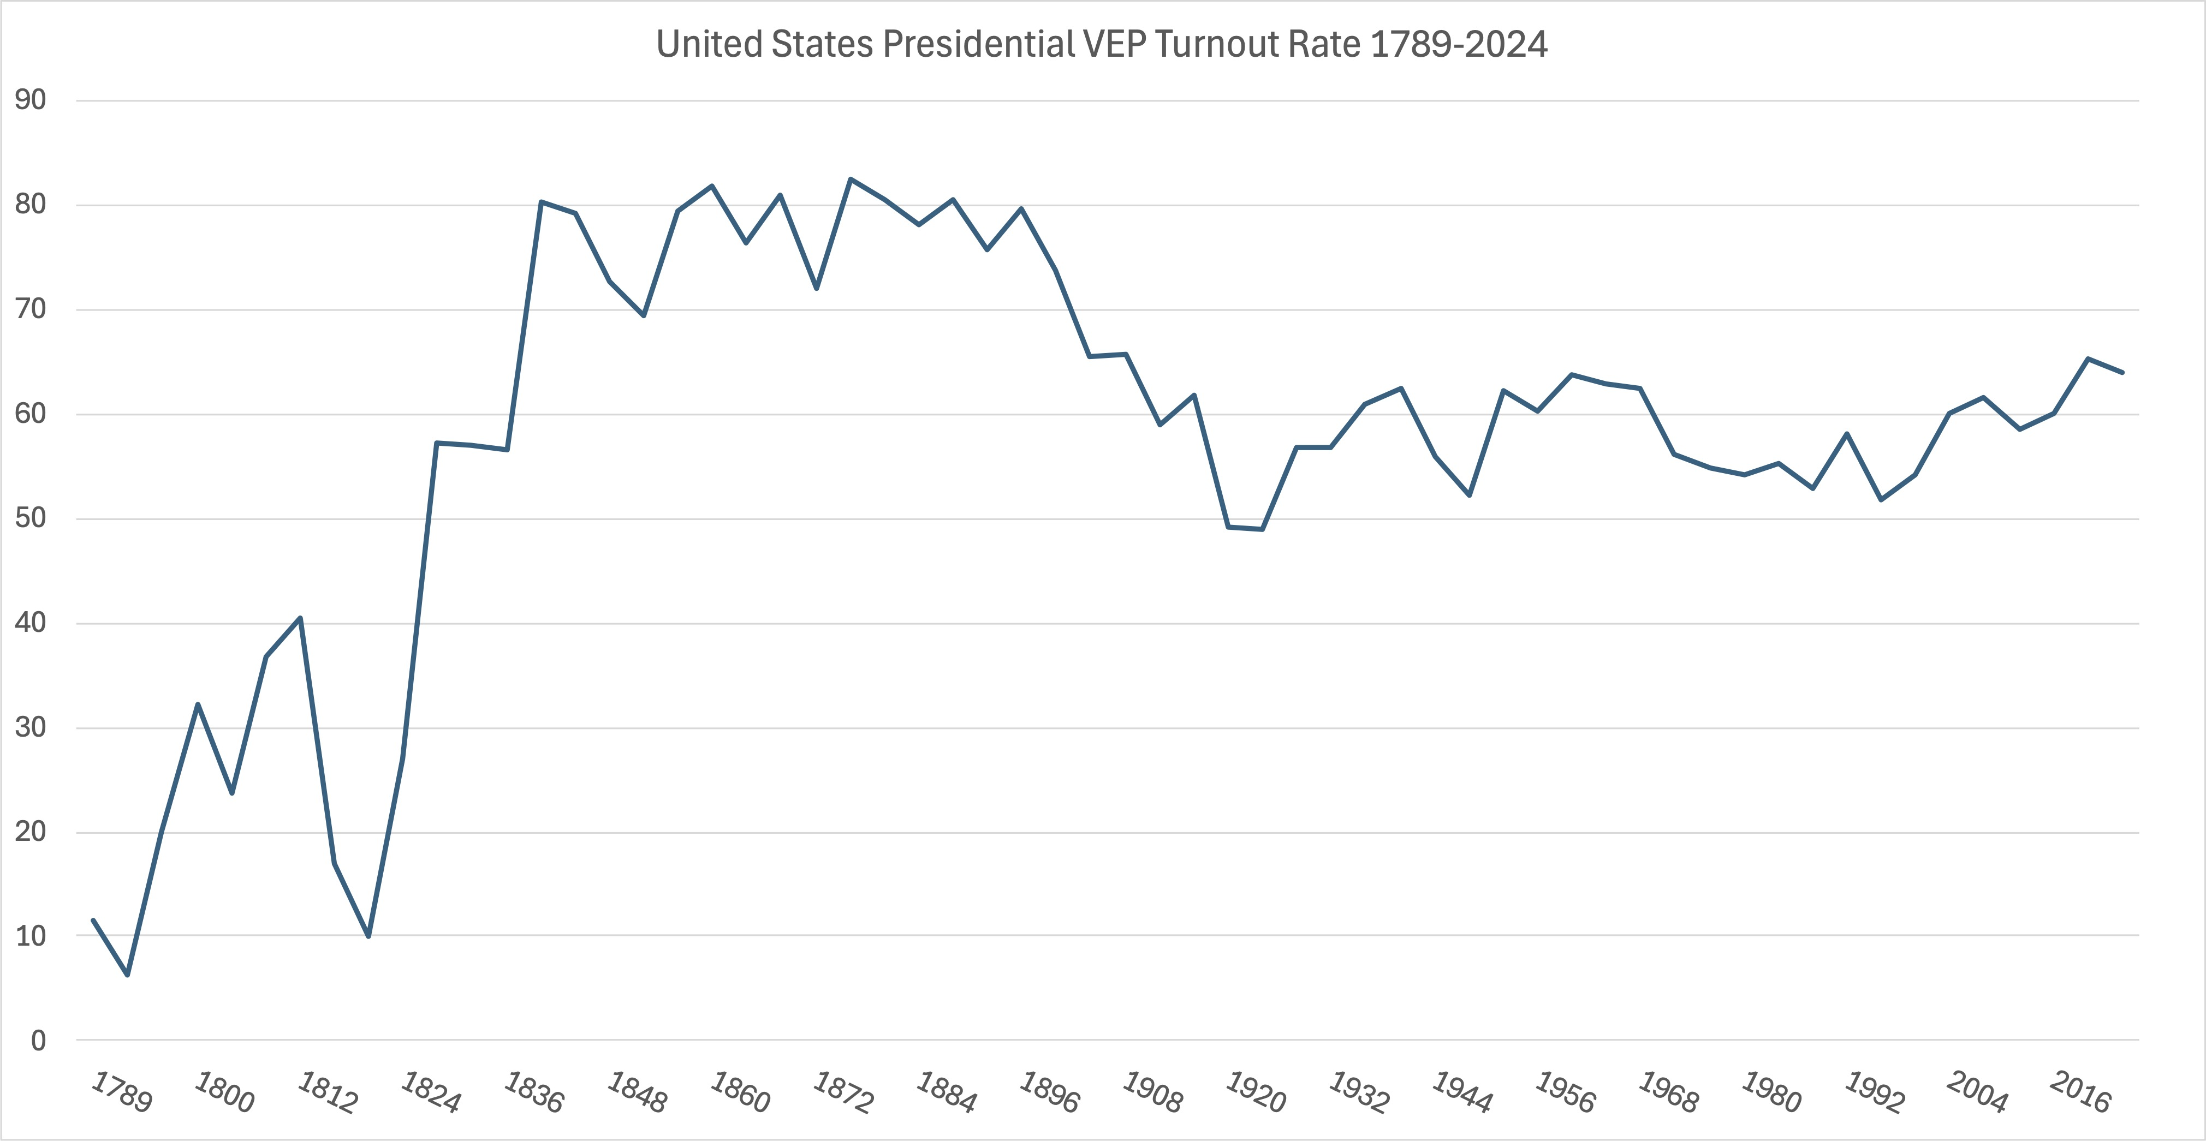
US VEP data
https://www.electproject.org/national-1789-present

Slide 8
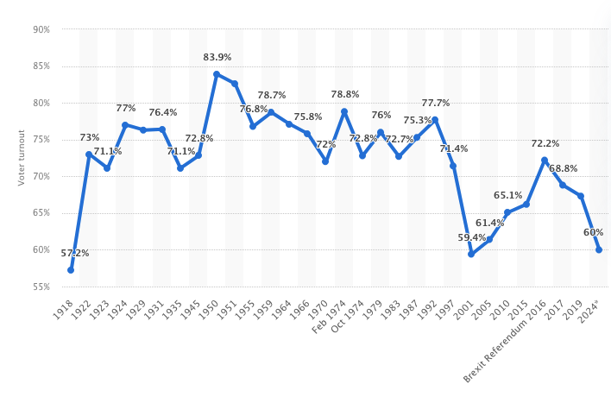
UK turnout (registration BASE) https://www.statista.com/statistics/1050929/voter-turnout-in-the-uk/
Notes:
Briexit referendum turnout 72.2

Slide 9

Why vote at all?
Downs: Probability of Voting= (Benefits[B]*Probability of Making a Difference [P]) – Costs [C] + Support for Democracy [or D for Duty]
Because ‘P’ is so small, setting aside ‘D’, hardly anyone should vote
And ‘D’ is inconsistent with a hardline rational choice model
But in a ‘reasonable choice’ model D simply represents the understanding that if no one voted, democracy would be ineffective

Slide 10

Social Psychological Model
Civic duty also to the fore in a social psychological model of voting: people don’t vote because they can’t, don’t want to, or nobody asked (Verba, Schlozman, Brady 1995, the Civic Voluntarism Model)
Can’t: social deprivation and marginality
No one asked: mobilisation
Not wanting to: socialisation and psychology
Mobilisation and Psychology – indicate the importance of group identities and social networks

Slide 11

The Competitiveness Model: Mark Franklin (2004)
People must think elections matter (B)
Parties must offer choices (B)
The outcome should not be predictable (P)
People acquire a habit of voting when young (D? or not)
Generational effects need to be separated from life cycle effects
Embedment in social networks reduces costs (C)
Different generations develop voting habits shaped by conditions when they first started voting (D?)

Slide 12

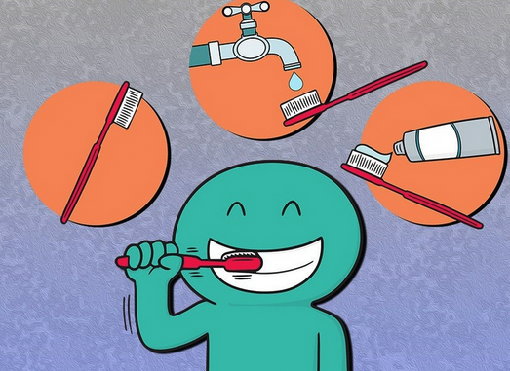
Duty or Habit?
Blais – civic duty not habit (Blais & Achen 2018; Blais & Daoust 2020)
Habit: context-behaviour associations in memory that develop as people repeatedly experience rewards for a given action in a given context.
Habitual behaviour is cued directly by context and does not require supporting goals and conscious intentions (Neal et al 2012)
Are norms and behaviour self-reinforcing and which comes first?
Is turnout the result of thinking fast or slow?

Slide 13
Measuring Civic Duty
QUESTIONS
If a person doesn’t care how an election comes out then that person shouldn’t vote in it (agree/disagree).
It is a citizen’s duty to vote (agree/disagree)
For you, first and foremost, is voting a duty, or a choice? While you may feel both responses are partly right, please indicate which of them applies most when you are voting.
Panel data – civic duty question asked at t-1? (Blais & Rubenson 2013)
The strength of cues on underlying social norms?
Or is it habit created by generational experiences that politics either matters or doesn’t (external efficacy)

Slide 14
External Efficacy
The belief that government will respond to one’s demands (Craig & Maggioto 1982)
‘People like me don’t have any say about what the government does’
‘I don’t think politicians and public servatns care much about what people like me think’
‘People like me don’t have any say about what the government does’
Internal efficacy, interest in politics, and political knowledge also important

Slide 15
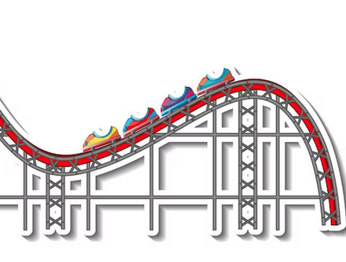
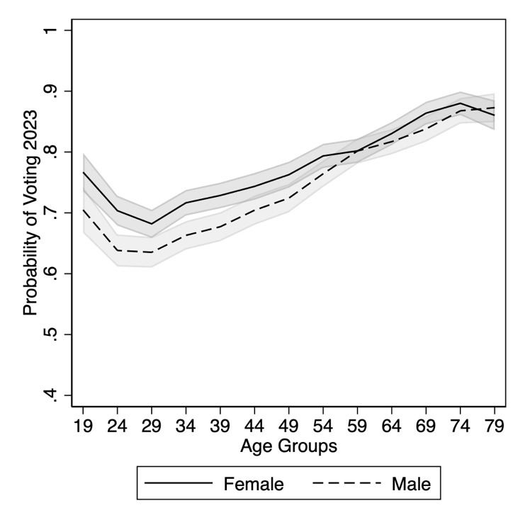
Life cycle and generational effects
Most studies of turnout show that the young vote less and the old vote more, except the very old (Smets & van Hamm 2013)
Longitudinal research shows that when people were born also matters – generational and period effects (Nemčok & Weiss 2021)
For example, those 18-24 in 2020 were significantly more likely to vote than those 18-24 in 2011
Big data research shows that age effects are even less linear than previous understood – a rollercoaster form (Bhatti et al 2012)…

Slide 16
Voting as a Social Act
People who live alone and in multiple-adult households less likely to vote than people in 2-adult households (Cutts & Fieldhouse 2001)
Going with other people to vote enhances turnout more than people going on their own: social pressure important (Gerber et al 2008)
Instability in housing and accommodation reduces enrolment and almost certainly turnout (Squire et al 1987)
Online voting has had minimal effects on increasing turnout (Solvak & Vassil 2018): perhaps because it make the act an individual one?
Advance voting may be more convenient, but does it make any difference to turnout? Apparently it does but also in conjunction with same-day registration (Garnett 2018)

Slide 17
Applications: Electoral Systems
PR has countervailing effects: proportionality increases turnout, party system fragmentation reduces it
Pre-electoral coalitions counteract fragmentation effects (Tillman 2015)
Positive PR effects strongest in full democracies, none in partial ones (Endersby & Kriekhaus 2008)
The most likely causal mechanism: uncertainty about effect of vote (under most PR no one can be sure it won’t matter)
PR systems have no seats where the outcome can be anticipated
FPP systems have safe seats for which everyone knows the winner (Selb 2009; Cox Fiva and Smith 2015)
However, effects small, and no robust effect found in New Zealand’s shift to MMP (Vowles 2010)

Slide 18
Applications: Socio-economic bias?
Liphart 1997: a concern about ‘unequal participation’
As turnout goes down, it goes down most among those with lower incomes and lower education
The higher the turnout, the higher the level of income redistribution (Blais et al 2020)
Polacko 2021:
Higher levels of income inequality significantly reduce turnout and widen the turnout gap between rich and poor
30 advanced democracies 1996-2016, integrated CSES dataset
When party systems are more policy-polarized, low-income earners are mobilized thus a significantly reduced income gap in turnout
Where party policies fail to represent the interests of low income earners, their turnout goes down

Slide 19
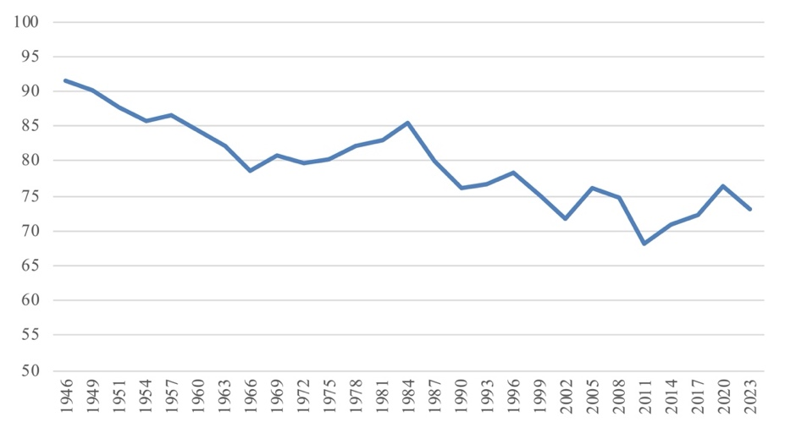
New Zealand? (age-eligible base)

Slide 20
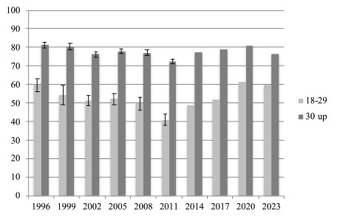
Turnout by Age 1996-2020
Source: NZES 1996-2011, Official Data 2014-
(Age-eligible base)

Slide 21

Age Cohort Differences (up to 2005)

Slide 22
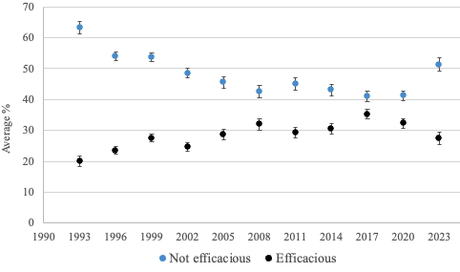
External Efficacy 1993-2024

Slide 23
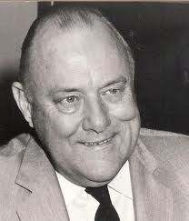
How has turnout decline been reversed?
The temporary turnaround, 1975-1984
revival of party memberships
mobilisation of a new generation of voters, party members, and leaders
new issue dimensions entered politics
Highly competitive elections
Polarised politics and divisive leadership (see Vowles 1994)

Slide 24
2011-2020?
2011 the lowest turnout in New Zealand’s democratic history (since female suffrage)
Subsequent three elections turnout up (not yet as many as the four consecutive elections 1975-84)
Steeper increase but from a lower base
Increased electoral engagement from the young goes against many contemporary interpretations of turnout decline
But why ?

Slide 25

Questions
Is voting a duty or a choice?
Is voting a norm or a habit?
What most motivated so many more young people to vote in 2020 – social and climate justice, or the cannabis referendum?

