Slide 1

POLS232
Public Opinion and Elections
Election Campaigns
Jack Vowles

Slide 2

Three themes
How have campaigns changed?
Do Campaigns Matter?
Fairness, Manipulation and Disinformation?

Slide 3
The Four Eras of Campaigning
Pre-modern – local party campaigns, face to face contact, newspapers, radio (up to 1950s)
Modern – television, national campaigns, much more use of mass media and ‘mediated linkages’ (1950s-1980s)
Post-modern – use of internet, phone banks, direct mail, more polling, focus groups, more intensive professionalization, marketing theory, voters as consumers, targeting and narrow-casting
Post-post modern? Further adaptation to more plural media as a conduit, traditional and non-traditional media, social media, use of big data, more targeting, more manipulation

Slide 4
Driving Factors
Technology
Professionalisation
Globalisation
Increasing Costs

Slide 5
Campaigns and their Effects
First, what is a campaign – is it permanent, or within a defined period prior to an election?
  Can it be defined by ‘intensity’ and ‘informational flow’?
In New Zealand: there is ‘a regulated period’ normally three months within which expenditure on campaign advertising is capped
An ‘election period’ one month within which parties and candidate can broadcast election material (for which they receive government funding that can also be used for social media)
Various aspects of campaign regulation have been reviewed as the legislation is becoming outdated as the result of technological changes
The Electoral Commission still complains that the legislation is outdated and needs further adaptation to the digital era

Slide 6
Do Campaigns Matter?
The right question to ask is how and much much campaigns matter
Early research based in the United States – campaigns were said to have minimal effects
Two main kinds of effect: persuasion and turnout
Most scepticism around the extent of persuasion
But even early on Lazarfeld, Berelson and Gaudet (1948) identified both reinforcement and activation effects
Priming effect as campaign made issues salient that tapped into voter predispositions

Slide 7
Minimal Effects
Reinforced by predictive economic models that could call the results of US Presidential elections months in advance
Data collected in US National Election Studies did not have sufficient pre-election data points to test for campaign effects
The US two-party system with relatively high levels of party identification was not the best context in which to test campaign effects
Even elsewhere, voting patterns relatively stable until dealignment process began in the 1970s
Increasing numbers of more detached voters the result…

Slide 8
New Methods
Johnston at al study of the 1988 Canadian federal election
Use of rolling cross-section method – interviews spread through campaign, followed up post-election
Two big issues: free trade agreement (the FTA) with the US, and the Meech lake Accord – a constitutional deal with the province of Quebec
The campaign focused on the FTA and in so doing primed voters to change their votes accordingly, boosting the Liberal Party
A seminal TV debate between the party leaders was a pivotal event
Powerful support for the reality of issue voting
Qualifier – there is a pre-campaign ‘equilibrium’ – a likely outcome – that the campaign usually reinforces, but sometimes it can shift on the margins, which can make a difference in a close election

Slide 9
The 2000 US Presidential Election
Annenburg Study (Johnston, Hagen and Jamieson 2004)
Democrat Al Gore won in popular votes but lost the Electoral College
Al Gore failed to prime voters sufficiently with evidence of good economic conditions: predictive models handed Gore a comfortable victory
Electoral College loss was no accident – Republicans had a funding advantage and targeted their advertising in swing states
In states where there was little or no advertising, Gore won votes because his attacks on Republican social security plans got traction – he won the news war but not the advertising war
In part this was poor judgement by the Gore campaign which did not keep enough $ to advertise strongly in the final week
US now has no effective expenditure limits – many other countries do

Slide 10
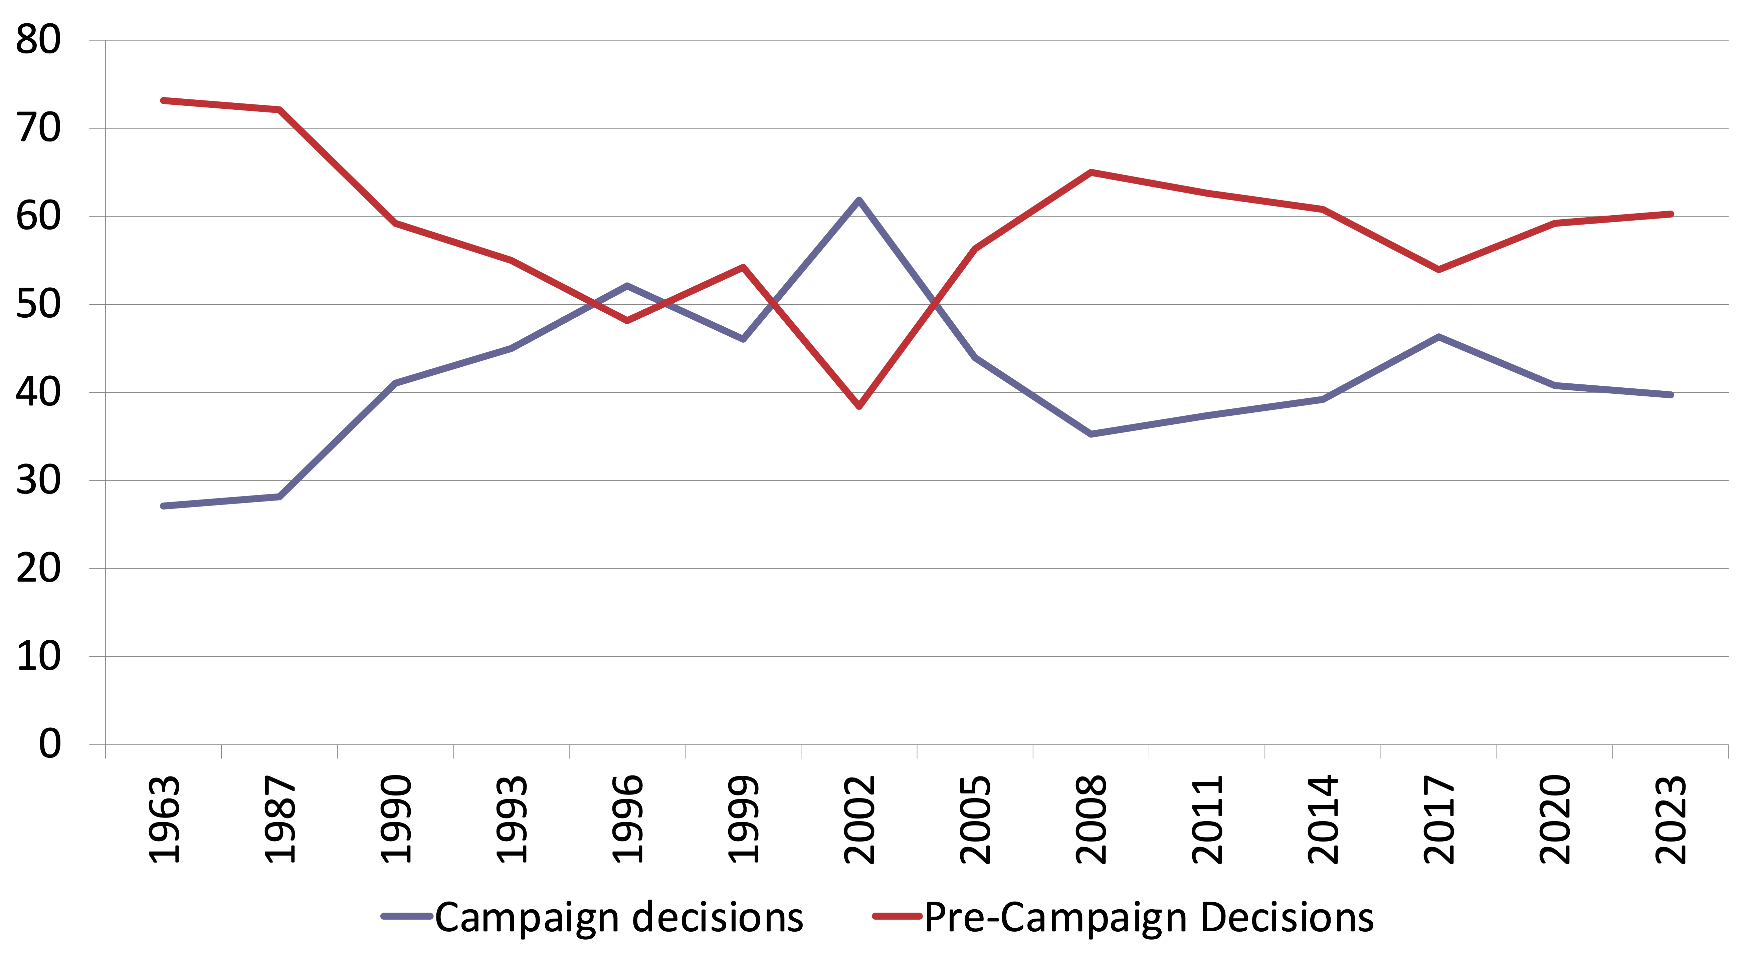
Campaign Decisions, NZES
How long ago did you decide for which party you would vote?

Slide 11
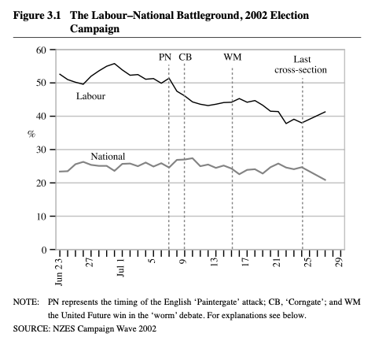
The 2002 Campaign
Labour entered the campaign with 50% or more support in the polls, ending up at 41.3% of party vote
National in the low to mid-20s, where it remained, and polled only 20.9% in the election
Campaign shifts toward Act, NZ First, and United Future

Slide 12
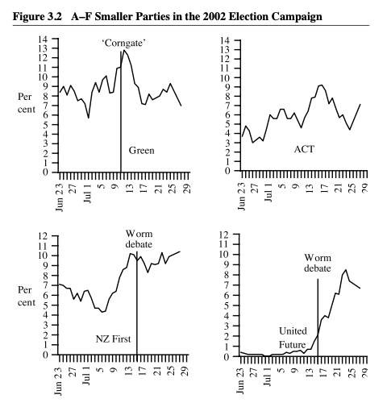
Corngate and the Worm: Small Parties

Slide 13
What shifted voters?
‘Paintergate’ began the slide
‘Corngate’ no significant statistical effects: may have stopped a Green trend which the Figure certainly suggests
‘The Worm’ – had negative effects on New Zealand First and Labour, positive effects reflected in liking for Dunne and his ‘common sense’ issue positions
Shift away from Labour issue positions, but Clark’s popularity acted against the trend
National made early gains on issues, but fell away halfway into the campaign
TV3 news coverage shifted voters away from Labour

Slide 14
Mobilisation
Domination of minimal effects meant focus on turnout effects
Strong early evidence that ‘canvassing’ and ‘knocking up’ - face-to-face/door-to-door campaigns could generate strong effects
Bochel and Denver (1971, 1972) – experimental research produced significant increases in turnout
Required at least three visits plus contact on election day with potential assistance to voting place
Post 1990s – Much US experimental research on ‘get out the vote campaigns’ (useful summary Green, McGrath & Arnow 2013)
Canvassing, direct mail, phone calls (commercial or volunteer)
Canvassing, social pressure mailing effective, email weak effects, texts more effective
Strong focus on US – not all findings may apply elsewhere

Slide 15
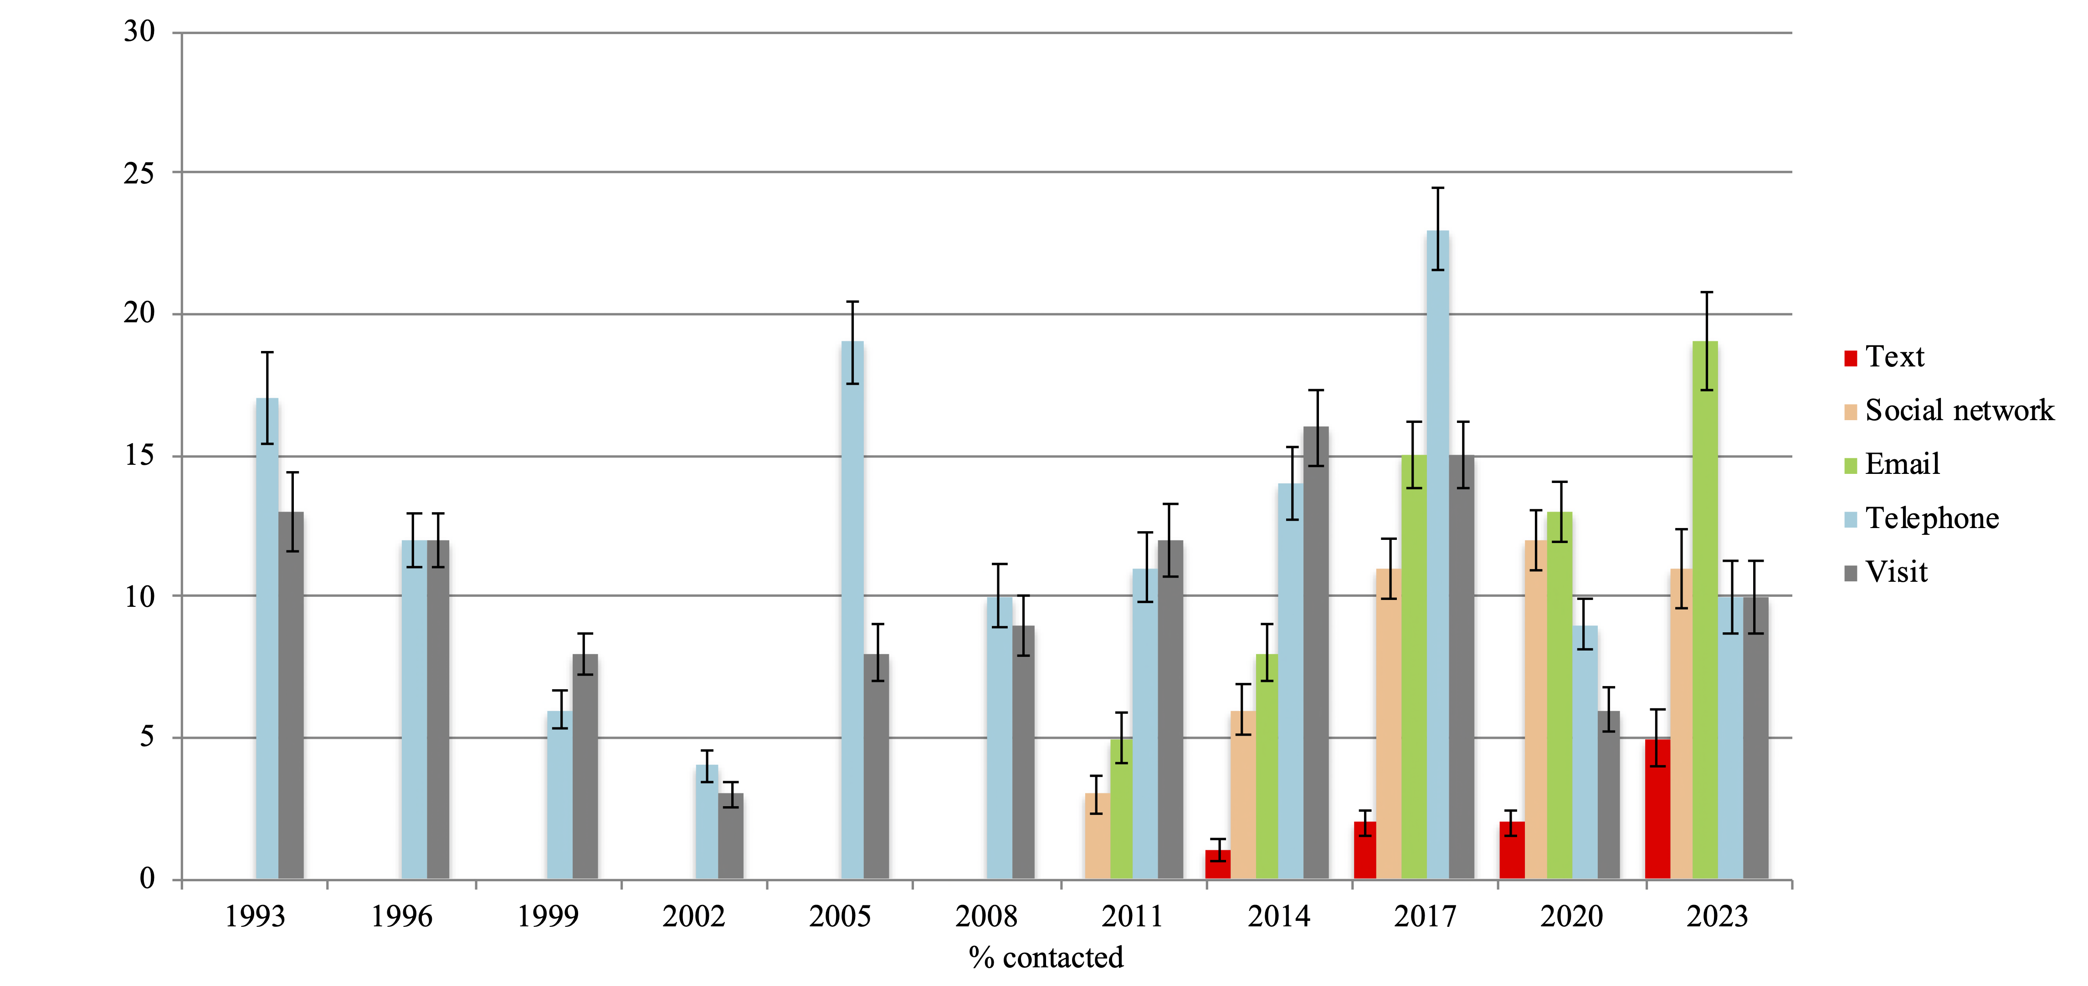
Party Contact in New Zealand Campaigns
Source: NZES Cross-Sections

Slide 16
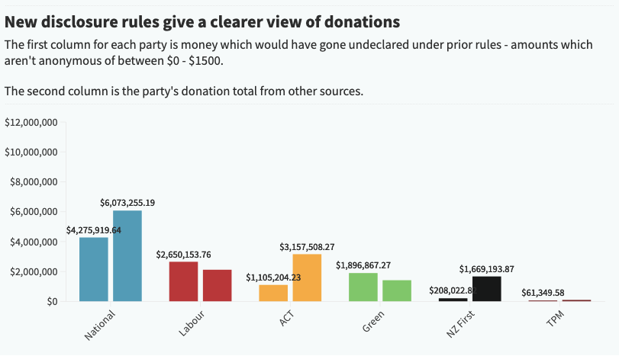
Party Donations 2023
SOURCE RNZ
https://www.rnz.co.nz/news/in-depth/523415/why-new-zealand-political-donations-have-more-than-tripled

Slide 17
Party Finances 2023
$ | Revenue | Expenses | Net Assets | Members
ACT | 4,554,215 | 6,676,875 | 613,944
Green | 3,910,333 | 3,934,536 | 1,082,637
NZ First | 1,818,077 | 1,889,650 | (59,413)
Labour | 6,549,429 | 7,229,022 | 2,723,199
National | 11,180,077 | 15,586,049 | 11,797,515 | 23,222
Te Pati Māori | 214,555 | 184,281 | 80,259
Table 1 Party financial data 2023, as declared by October 2024
SOURCE: Electoral Commission, Annual financial statements. https://elections.nz/democracy-in-nz/political-parties-in-new-zealand/annual-financial-statements/

Slide 18
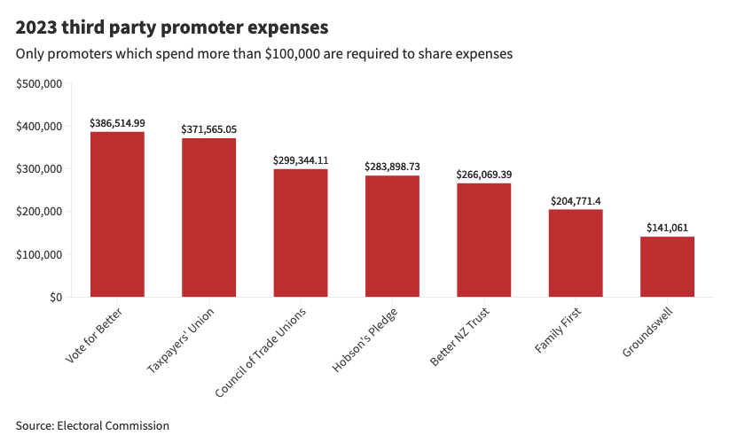
Promoters 2023
Huge increase in promoter expenditure in 2023 from $145,000 in 2020 to $1,953 in 2023 (highest ever).
https://www.rnz.co.nz/news/in-depth/510208/2m-surge-in-election-campaign-spending-by-third-party-groups
Vote for Better: Racing Industry
Better NZ – Retain EV discount

Slide 19
Manipulation and Disinformation
Psychometric profiling (Cambridge Analytica), the use of dark ads, bots, trolls, and fake news
‘With big data, campaigns know whom you will vote for, even before you do”
External foreign actors, international networks of digital consultants, depoliticised campaign organisation
Polarisation and division as strategy, analytics used to deliver on goals
Negative advertising intended to demobilise voters and discourage turnout
Focus on ‘voter fraud’ to tighten registration and voting eligibility, raising costs of voting for some social groups
Disinformation strategies
Attacks on politician’s character, scandals
A lot of this is not new….

Slide 20
Upsides?
Reduced costs of social media make it easier for civil society groups to organise, communicate, within to their members and supporters, and without to the wider public
Increasing use of voting advice applications (VAAs) during campaigns give people more information about party policy options
Greater sophistication in party research capacities may have some positive elements such as potentially better understanding by party elites of voter priorities and concerns
Increased focus on ‘fact-checking’ by at least some traditional media, retaining a commitment to balance and ‘truth’
Reasonably informed people can readily find information online and many do know the difference between good and bad sources
Efforts to demobilise targeted groups often have the opposite effects
Psychometric data used by Cambridge Analytica probably didn’t have the dire effects claimed
  https://www.theverge.com/2018/3/20/17138854/cambridge-analytica-facebook-data-trump-campaign-psychographic-microtargeting

